Slide 1
Azure Synapse Analytics Azure SQL Database Azure Databricks
When to use?
Why?
Notes:
Technology democratization has led to make available the best features and the killer open-source frameworks to be available in almost all products in a line. Although the cloud provider used in one’s company takes priority, it makes it difficult to choose the best that fits for requirement. In this session, let me share my learnings, how our team analysed different frameworks for use cases. I hope it would help someone to choose the right data analytics tool for his need.

Slide 2




About Me
Dinesh Kumar P
Product Manager,
Reports & Analytics Squad.
https://www.linkedin.com/in/dinesh-kumar-prabakaran
Notes:
Myself currently working as a product manager, for the analytics and reports squad at Kissflow. Coming through 8+ years of the journey around data space, I have involved in implementing B2B SaaS products for Big Data, ETL, and Business Intelligence.

Slide 3
Agenda
* Demystify – Database, Data warehouse, Data Lake, Data Lakehouse.
* Best fit scenarios for choosing DB, DW, DL and DLH.
* Azure Synapse Analytics, Azure Databricks.
* Common features but different in Synapse and Databricks of Azure.
* When to use SQL DB, Synapse, Databricks?
* My use case and what we choose?

Slide 4
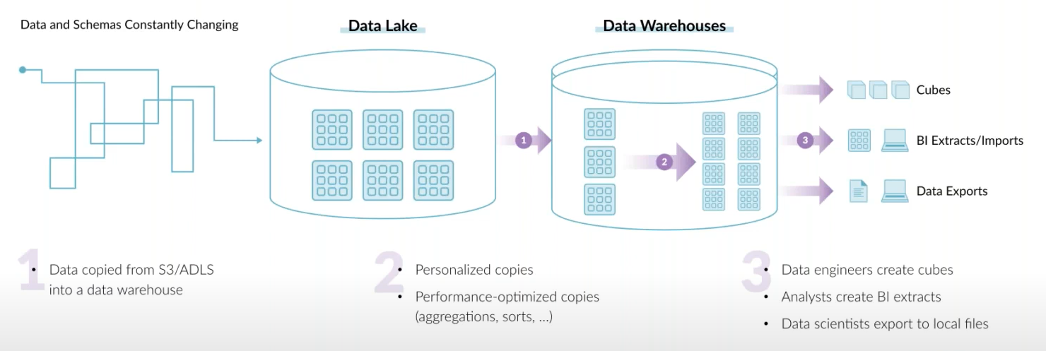
End goal of a data architecture – Allow USER to take SMART decisions
* Define your goal well.
* Don’t choose a data tech stack, just because you / your team knew it well.
* Try reduce copies. It is a key obstacle to data democratization & fast time to value.
Notes:
Cloud provider that uses sometimes play a vital role in filtering out options. But a general advice is be careful in that. If a service in other cloud provider you feel really useful, take it to the discussion what really different + useful than own provider’s product.

Slide 5
Data persistence

Slide 6
Database, Data warehouse, Data Lake, Data Lakehouse.
- Demystify.
- Best fit scenarios to choose one.
Notes:
This is a crazy and slightly confusing time in the data architecture space. More and more companies are shifting towards data lakes, yet the traditional data warehouse and database continues to provide value, as it has for decades. Now to add that, we have this increasingly popular lakehouse and delta lake concept.

Slide 7
Database
* Co-location of Compute & Storage.

Slide 8
Data Warehouse
* Separation of Compute & Storage

Slide 9
Data Lake
* Separation of Compute & Data

Slide 10
Data LAKEHOUSE
* Sting together the best of both worlds – Data warehouse and Data lake.

Slide 11
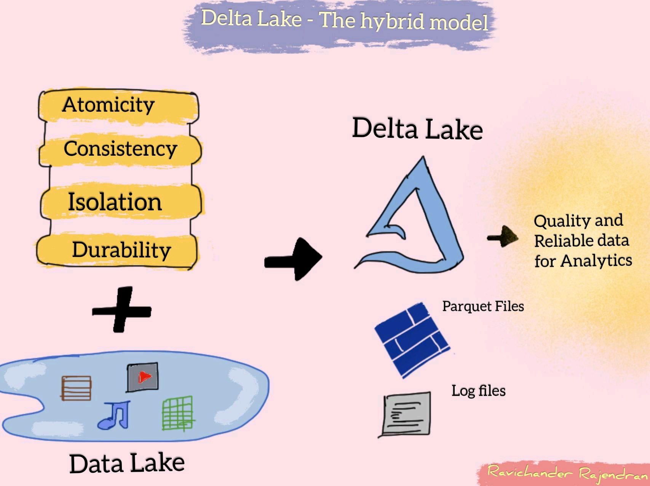
Delta lake – The hybrid model

Slide 12
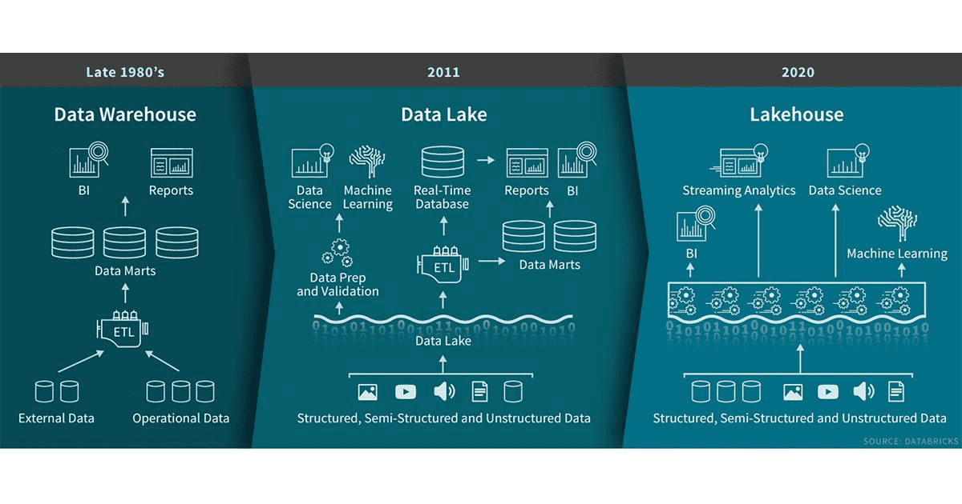

Slide 13
Azure Synapse Analytics Azure Databricks
ISP of product.
Common features but how its different in each?

Slide 14
Azure Synapse Analytics

Slide 15
Azure databricks

Slide 16
Common features
Common Feature | Azure Synapse Analytics | Azure Databricks
Apache Spark | Open-source. | Latest from Databricks.
Jupyter Notebooks | Nteract notebooks. | Databricks notebooks with realtime co-authoring and automated versioning.
Access data from a Data Lake | Easier to query from sql scripts and notebooks. | Need to mount and then query.
Delta Lake | Open-source. | Latest from Databricks.
Storage and Compute separated | SQL on-demand pool | Autoscaling pool

Slide 17
When to use synapse and/or databricks
Use cases | Preferred
ML/AI development – GPU oriented | Databricks
Ad-hoc data lake discovery | Both Synapse and Databricks
SQL analyses & Data warehousing | Synapse
Self-service BI / Reporting | Synapse
Scenario | Preferred
Spark engine by data scientists & traditional SQL engine by data analyst on same data. | Synapse
Dependent tech stack E.g. Delta Lake / Spark | Databricks
Local IDEs with GIT kind of developer experience | Databricks
Notes:
Not going to repeat the points which I spoke earlier. I mean core features of Data warehouse / Data Lake / Data Lakehouse.

Slide 18
Kissflow’s use case
* Kissflow is a pure SaaS product hosted on GCP.
* Nature of product - Customers (business users) develop workflow apps by themself.
* Transaction database of app - MongoDB Atlas. 1 DB per customer.
* Each customer will have their own schema (data model).
* No separate analytics database as of now.
* Based on our product nature, per customer data won’t be huge.
* Analysed Data Lake, Database and chosen to go with Data warehouse for which the final investigation is going on.
Notes:
Data warehouse we opted is Snowflake.

Slide 19
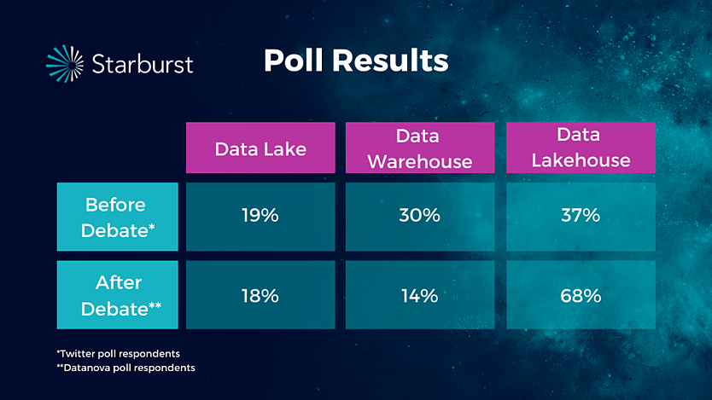
Next few years – how the choice would be

Slide 20
Resources
* Blog post by Ivana Pejeva - https://www.element61.be/en/resource/when-use-azure-synapse-analytics-andor-azure-databricks
* Checkout debate with proponents of each architecture at Datanova 2021 hosted by Cindi Howson

